Slide 1
Introduction to parallelism in C++ with Intel Threading Building Blocks
Andrea Bocci
CERN

Slide 2
parallelism in C++ 11

Slide 3
parallelism in C++ 11
C++ 11 introduced the building blocks to express parallelism in C++
  threads:
    std::thread
    std::jthread (since C++20)
  critical sections: “mutual exclusion”
    std::mutex, …
  and locks:
    std::lock_guard,
    std::scoped_lock (since C++17), …
  atomic operations:
    std::atomic<T>,
    std::atomic_ref<T> (since C++20)

Slide 4
parallelism in C++ 17
C++ 17 introduced parallel algorithms and execution policies to express parallelism
  std::execution::sequenced_policy
    may not be parallelized
    serial execution, same as the legacy algorithms (?)
  std::execution::parallel_policy
    may be parallelized
    may run in the calling thread or in other threads managed by te library
  std::execution::parallel_unsequenced_policy
    may be parallelized, vectorised, or migrated across threads
  std::execution::unsequenced_policy (since C++20)
    may be vectorised, e.g. with SSE, AVX2, AVX512, etc.
  if you can express your problem using algorithms,
  parallel algorithms give you a simple way to leverage parallelism to speed up your code

Slide 5
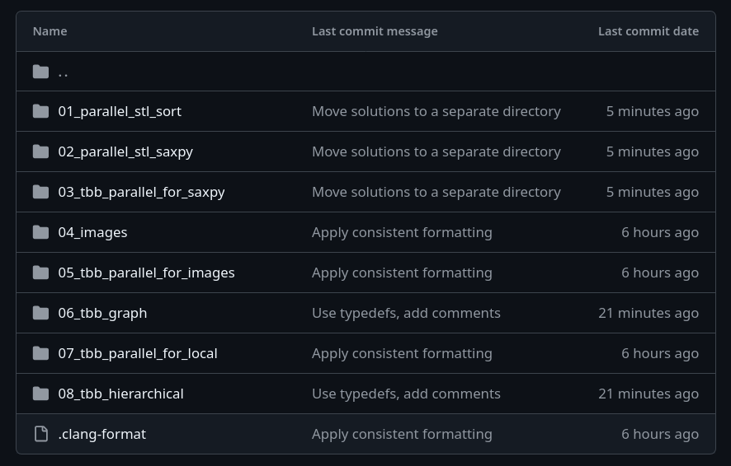
hands-on exercises
hands-on/tbb/:

Slide 6
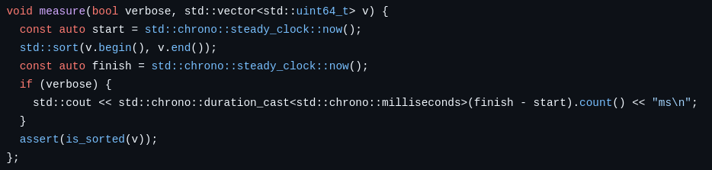
parallel algorithms: sorting
hands-on/tbb/01_parallel_stl_sort/test.cc:
  generate 1’000’000 random numbers
  measure how long it takes to sort them
    repeatedly
  use the parallel STL to speed up the sorting

Slide 7
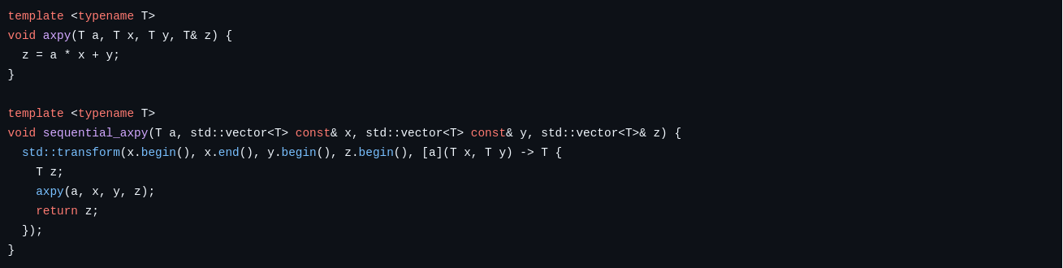
parallel algorithms: user functions
hands-on/tbb/02_parallel_stl_saxpy/test.cc:
  generate a random scalar number x
  generate two vectors of 100’000’000 random numbers A and B
  measure how log it takes to apply the “saxpy” kernel to the vectors
    (single precision) A x + B
  use the parallel STL to speed up the operations

Slide 8
parallelism with Intel TBB

Slide 9
parallelism with Intel TBB
Intel Threading Building Blocks
  now part of the oneAPI branding: oneTBB
  including the official documentation and reference
  migrating from the original TBB to oneTBB requires some small changes
why TBB ?
  scalability and load balancing
  composability
  multiple levels of parallelism
    task-based parallelism: parallel_invoke, parallel_pipeline, various graph types
    fork-join parallelism: parallel_for, various parallel algorithms
  access to low level interface
    task_group, task_arena, observers, etc.

Slide 10

Pro TBB
Pro TBB (2019)
  Voss, Asenjo, Reinders
  https://doi.org/10.1007/978-1-4842-4398-5
  open access book
all examples in the book are on GitHub
  https://github.com/Apress/pro-TBB
the book describes the old TBB API
  prior to the migration to oneTBB
  use the oneTBB branch !

Slide 11
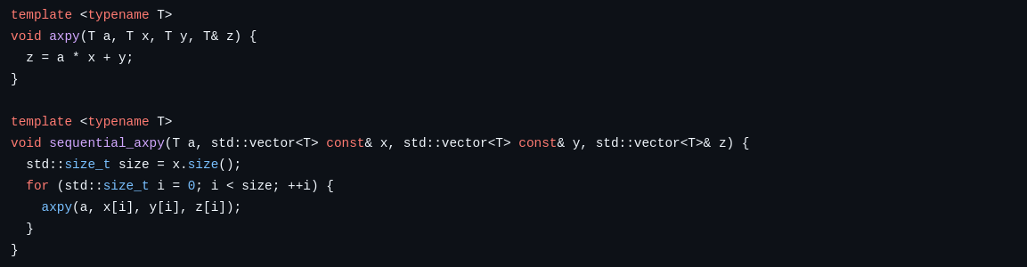
saxpy with TBB
hands-on/tbb/03_tbb_parallel_for_saxpy/test.cc:
  generate a random scalar number x
  generate two vectors of 100’000’000 random numbers A and B
  measure how log it takes to apply the “saxpy” kernel to the vectors
    (single precision) A x + B
  use tbb::parallel_for to speed up the operations

Slide 12
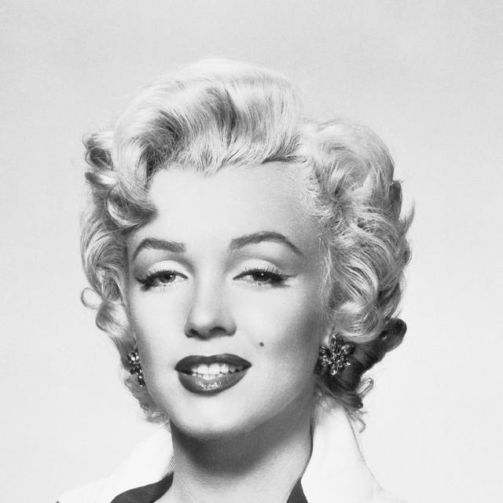
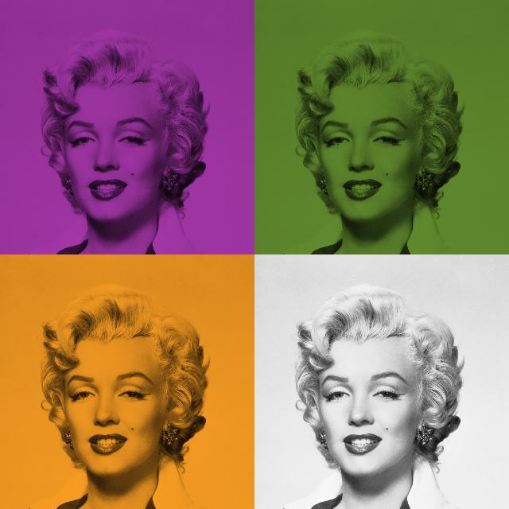
Art @ ESC24 !

Slide 13
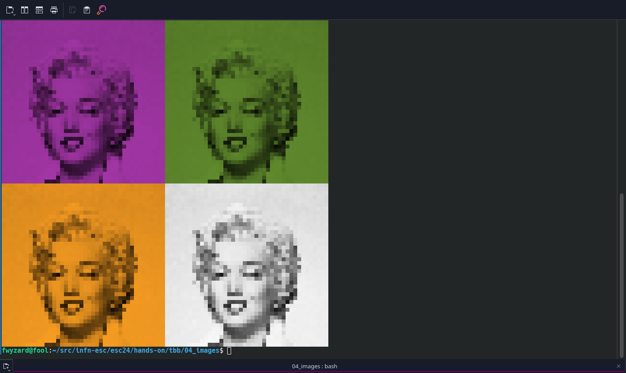
dependencies
stb_image.h and stb_image_write.h reading and writing image files
{fmt} for formatted output
  gcc 12 does not include c++20 std::format
  {fmt} includes a lot more !
both libraries can be used in header-only mode
  increases compilation times
  easier to set up
all: test
stb:
git clone https://github.com/nothings/stb.git
fmt:
git clone https://github.com/fmtlib/fmt.git
test: test.cc Makefile stb fmt
g++ -std=c++20 -O3 -g -Istb -Ifmt/include -Wall -march=native -ltbb $< -o $@

Slide 14
our task list
hands-on/tbb/04_images/test.cc:
  read one image from a file
  display the image on the terminal
  make a 0.5×0.5 smaller copy of the image
  convert the image to gray scale
  make tinted copies
  combine the gray scale and tinted images into
  a single image with the same size as the original
  display the image on the terminal
  write the image to a file

Slide 15
multiple levels of parallelism
with TBB we can easily (?) express multiple levels of parallelism
  algorithmic parallelism: parallelise the inner loops in the various algorithms
    scaling
    gray scaling
    tinting
    very dependent on the algorithms
  task-based parallelism: parallelise the different tasks working on the same data
    apply the different tints can be done in parallel
      note: this is not an efficient approach… why ?
    writing to disk in parallel in parallel to displaying on the terminal
    very dependent on the workflow
  data parallelism: process multiple images in parallel
    weak scaling
    often the most efficient approach for large datasets
composability: you can also apply all of them to the same problem !

Slide 16
hands-on exercises
hands-on/tbb/:

Slide 17
questions ?

